Slide 1



CAREER GUIDANCE
in vocational training centers

Slide 2

Legal background career guidance activities
provision of information aimed at vocational training
personalised workshop visits
Law on Vocational Education and Training, § 348. §
trying out professions
giving lectures
organization of joint events
operation of a vocational training advisory network
Professional program
participation of specialists in mandatory sessions
organization of specialized student groups and thematic summer camps
assessment of student needs in the form of a questionnaire
interactive tasks, movies and games
organization of academic competitions

Slide 3
Platforms for information on vocational training
Schools’
websites
Facebook
YouTube
NT/NV
A subsample of 9th graders and 16-year-olds
NSZFH 2023 questionnaire survey

Slide 4

Reasons for choosing vocational education and training
Here I can learn something that interests me.
All respondents 9th graders
NSZFH 2023 questionnaire survey

Slide 5

The circumstances of choosing the current training
With this qualification I will find a job easily.
At the suggestion of my parents or another relative.
At the suggestion of my teachers.
All respondents 9th graders
NSZFH 2023 questionnaire survey

Slide 6

NSZFH survey focal points September 2023
    What career guidance publications are produced, and where and how they are promoted?
Questions
What data do they have regarding the frequency and success of the publication?
    What kind of events are organized, who are the cooperating partners, how do they measure the success of the event?
    What professionals are involved in career guidance?
Which activity do they see as the most successful and
what suggestions do they have for increasing efficiency?

Slide 7

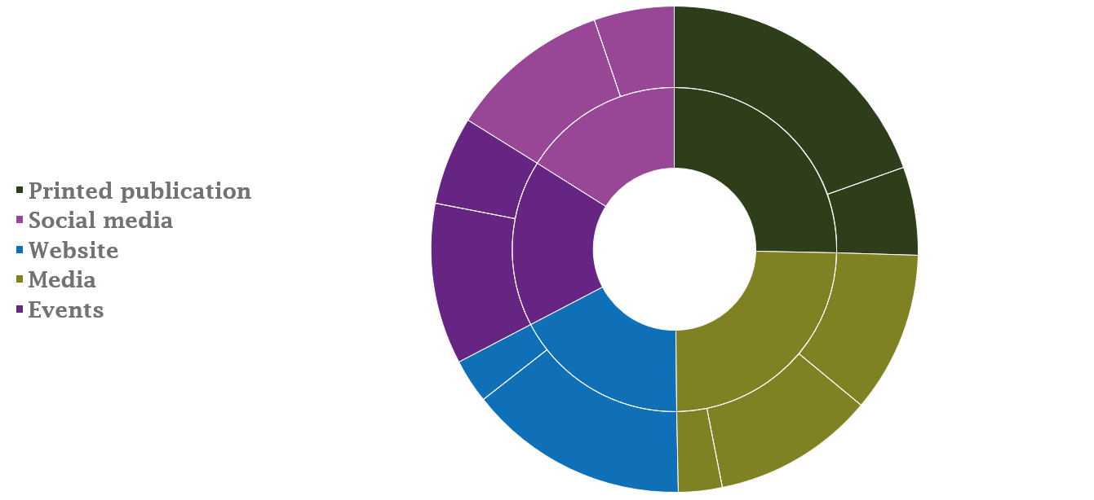
Tools used during career guidance activities
VET Centre appearance
Institutional appearance
Institutional publication
Social media
Printed publication
Institutional, sectoral
VET Centre publication
Events
Comprehensive
Local TV, radio
Website
Media
VET Centre
Institutions
Online media
Printed

Slide 8








Cooperating partners of vocational training centers
Regional chambers
Primary schools, school districts
Companies
Municipalities,
government offices

Slide 9

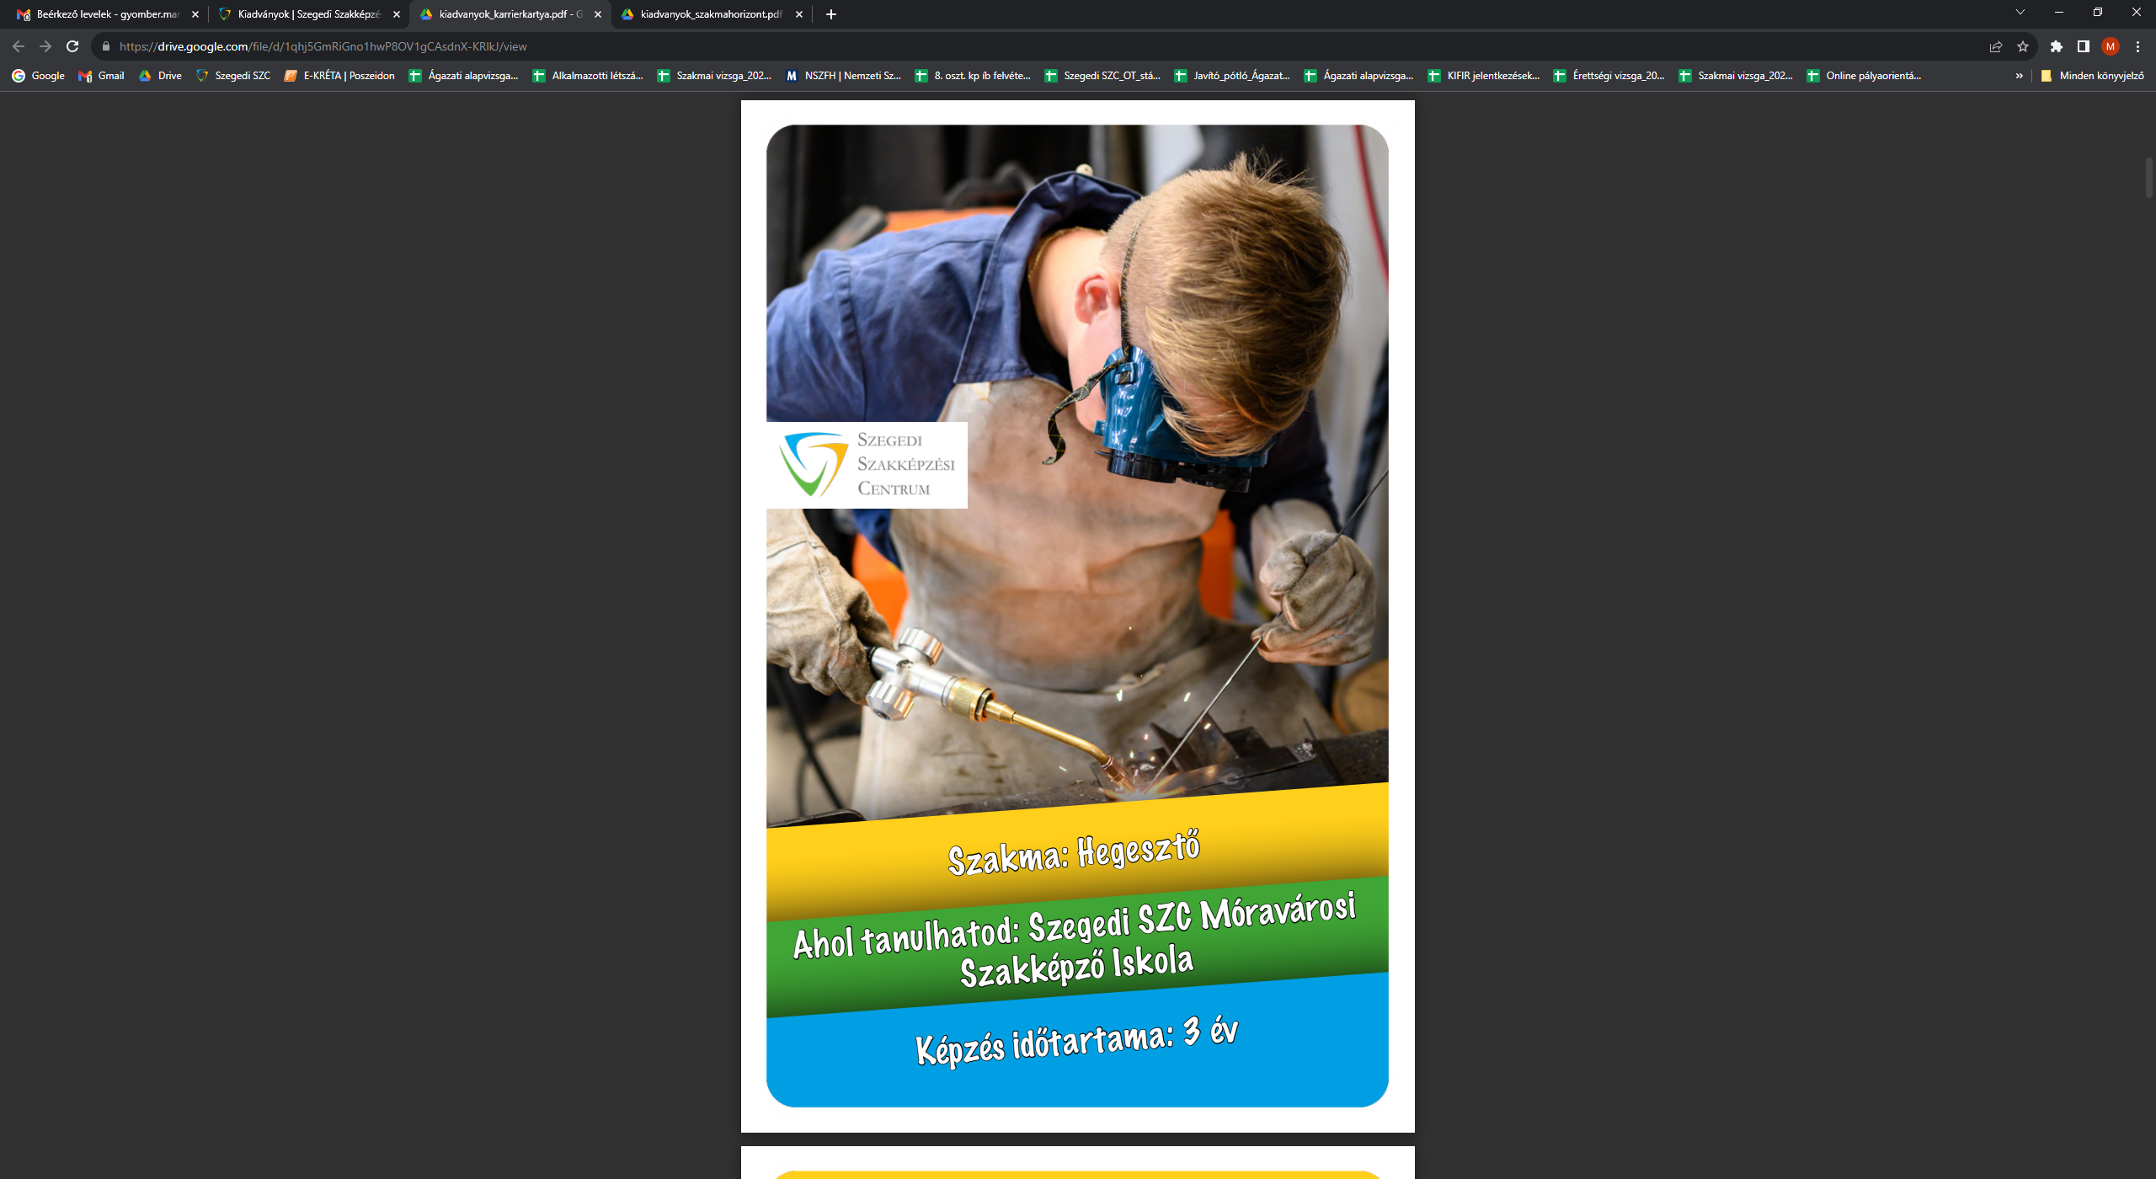
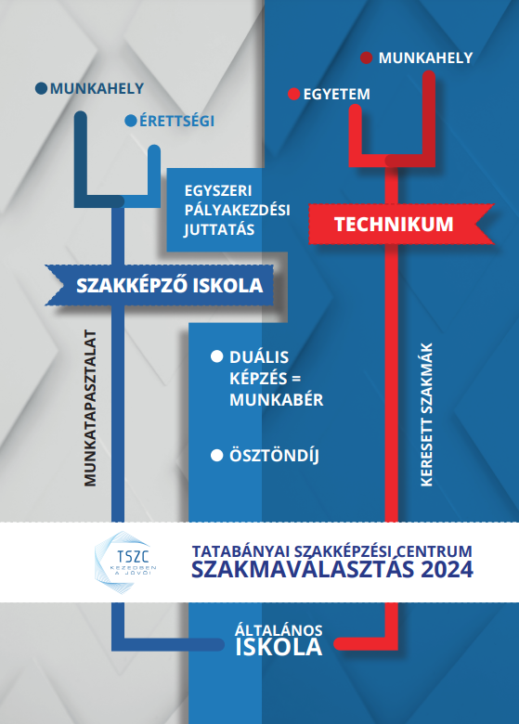
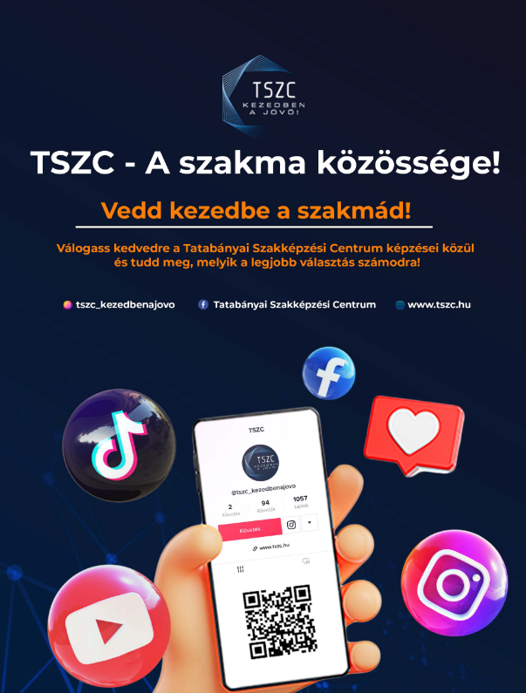
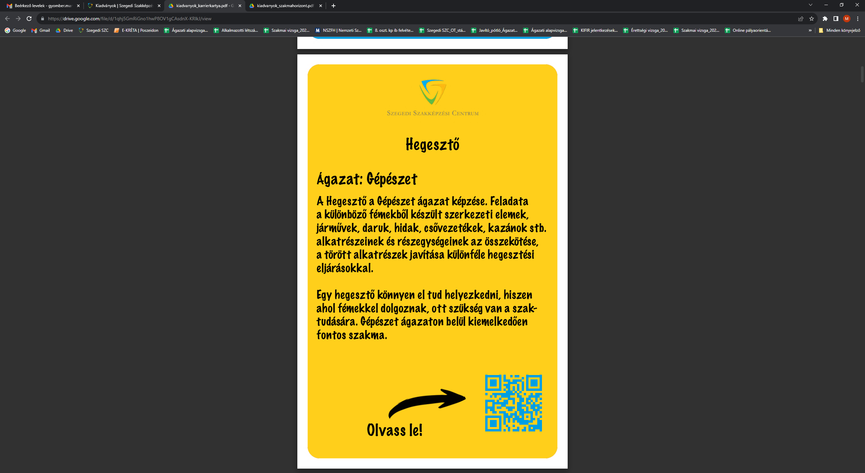
Career guidance publications

Slide 10


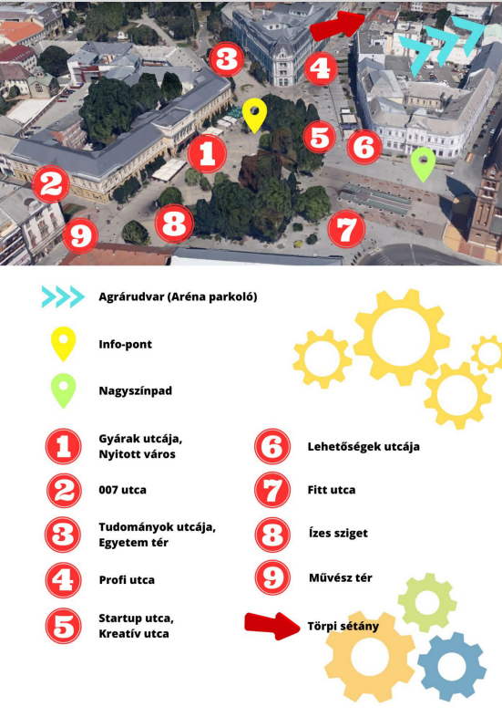
SzakMAfest, Festival for Professions – all-day event in Nyíregyháza
Employment Pact Nyíregyháza
The town turned into the ministate for professions
Thematic streets of professions

Slide 11
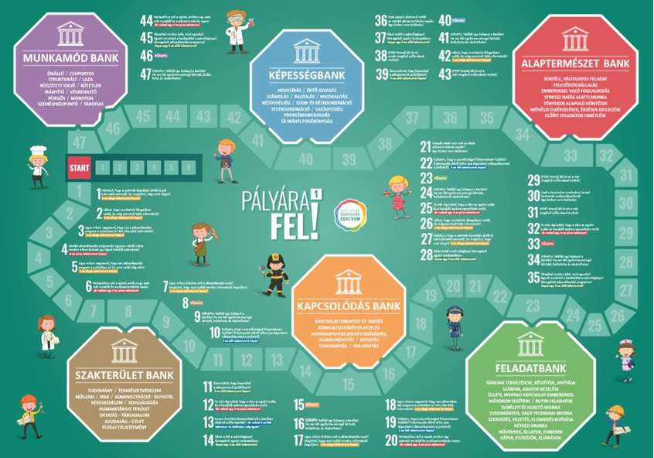
„Pályára fel!” Career on! Boardgame of Székesfehérvár Training Centre
Guidelines, thematic leaflets
(career guidance mini- library)
Games
(group, dramatic, contests etc.)
Preparation courses
for using methods, tools, and event organizations
Network
for teachers supporting career guidance és and supply them with tools
Software packages
Age groups
13-15 and 16+
https://palyaorientacio.szfszc.hu

Slide 12

„Én utam” (My way) Euroguidance boardgame
Guideline
for professionals
Boardgame
age groups
11-20
Workshops
For professionals
Support students in developing decision-making skills and strategic thinking
Free
for all interested parties

Slide 13
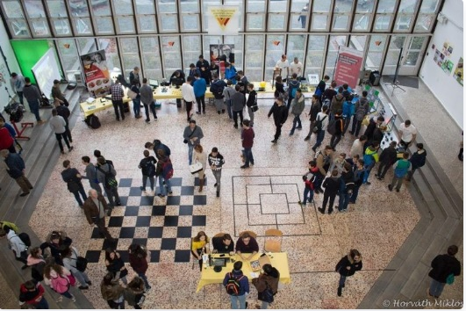
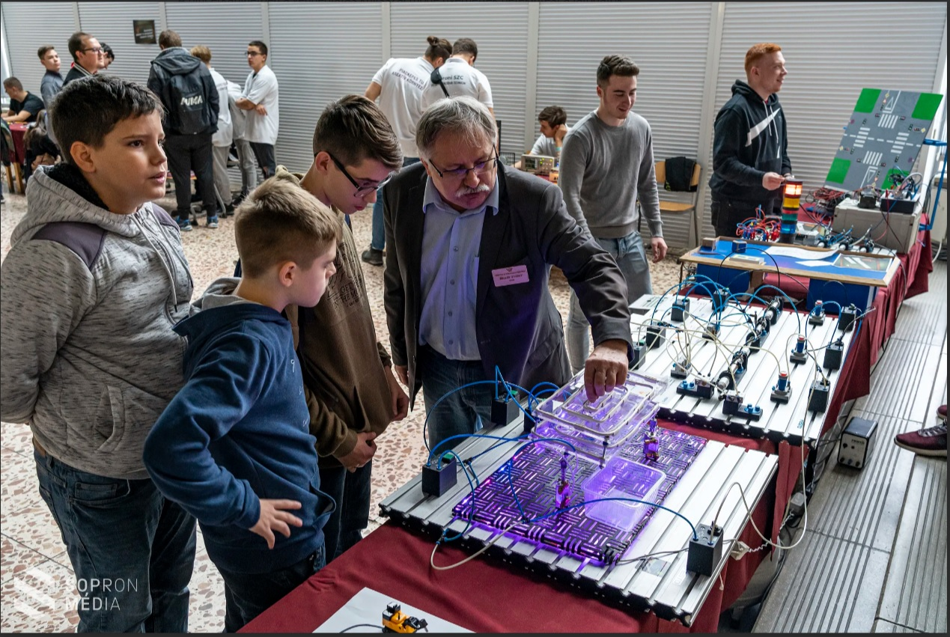
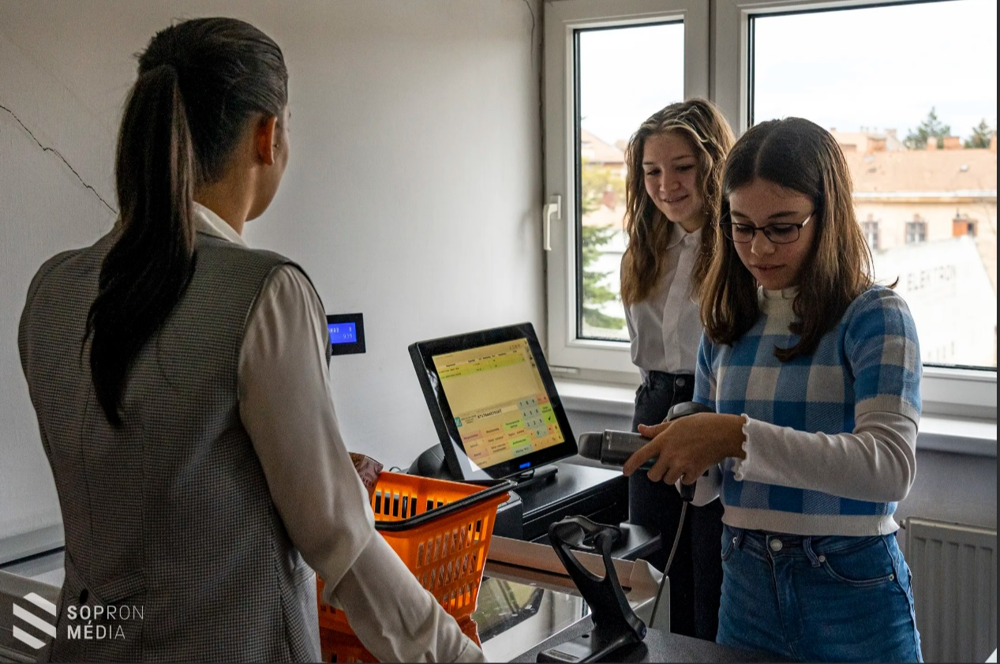
Morning of professions in Sopron Vocational Training Centre

Slide 14
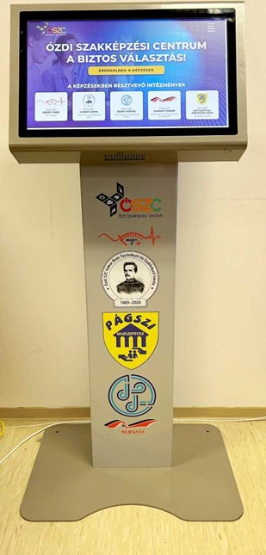
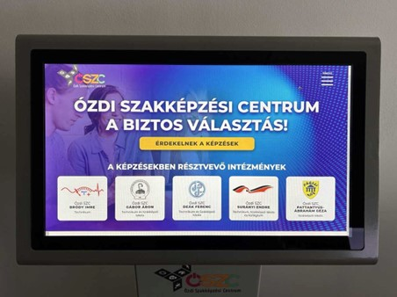
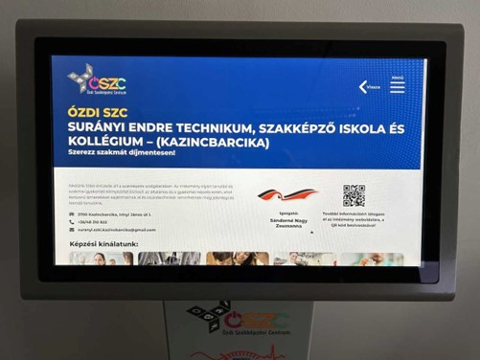
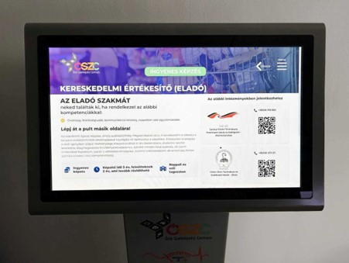
Information desk in primary schools – Ózd Vocational Training Centre

Slide 15

Career guidance training for primary school teachers
Further training of 14 state and church-run primary school teachers in the Digital Community Creation Workshop (DKA) of the Váci Vocational Trining Centre
Training and workshop methodology
The participating students filled out a questionnaire at the beginning and at the end of the training

Slide 16







Career guidance specialists
Career guidance specialist at the Vocational Traning Centre 50%
Career guidance working groups
External specialists
Instructors
Managers

Slide 17
According to the majority of the Vocational Training Centres, the most effective activities are Career Exhibition and Days, Roadshows, Open School Days, and Parents’ meetings organized together with the dual partners.
It is important to promote the vocational training system on all channels.

Slide 18




Budapest, Bajcsy-Zsilinszky u. 53. 1065
Thank you for your attention
+36-1/ 434-5772
szfoigh@nive.hu
Notes:
So these are the main characteristics of our constantly developing Vet system.

